Slide 1



<NAME OF THE PROJECT>
‘WajihTaxi’
IBRAHIM HASSAN
Wajih Salahiddin
Python Junior
2023 – 2024
Notes:
1. INTRODUCTION

Slide 2
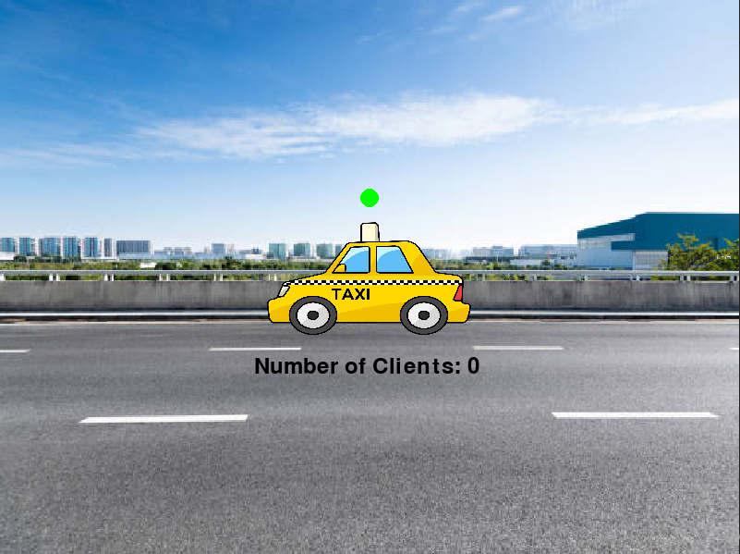
<NAME OF THE PROJECT>
To make this project, i got inspired by my own experience of taking taxis . I was really struggling to know if the taxi is available or not.
So i made my project :
“TAXI WAJIH”
IBRAHIM HASSAN
This project can work effectively in the real taxis because it will help citizens to take taxis faster.

Slide 3
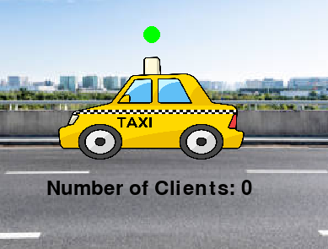


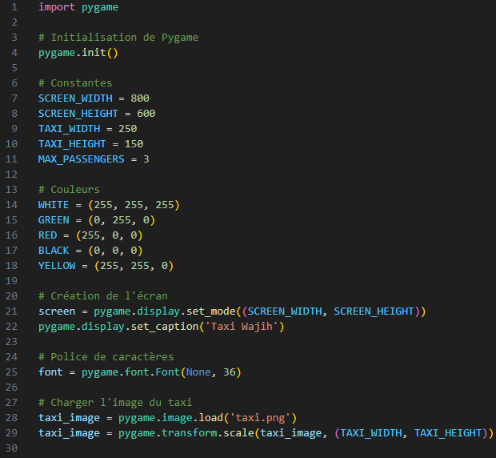
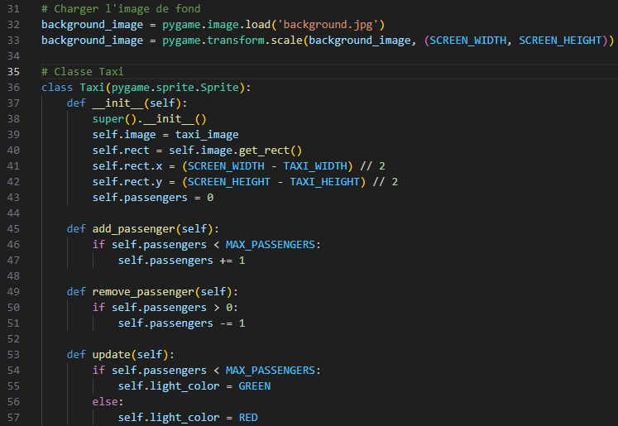
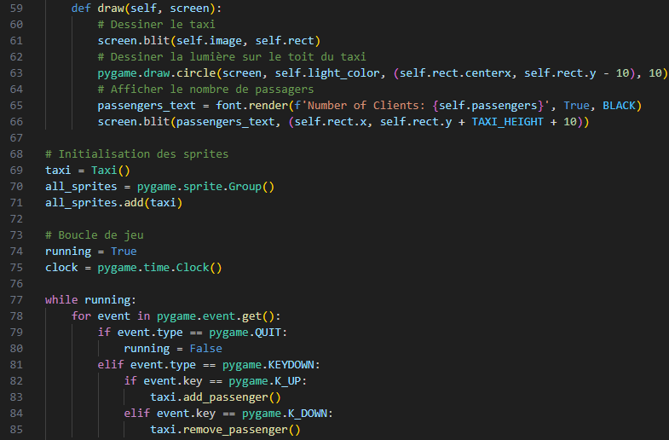
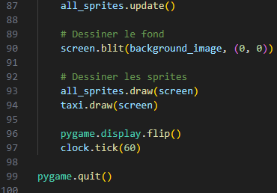
IBRAHIM HASSAN

Slide 4
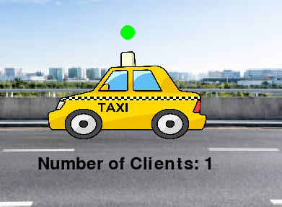
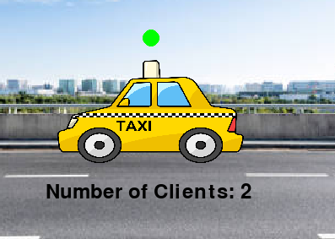
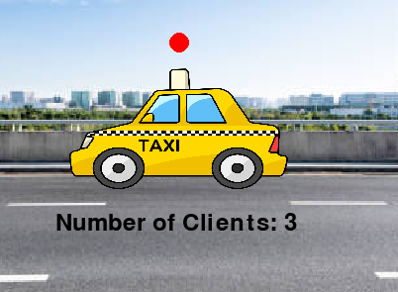
The result of the program looks like this :
<NAME OF THE PROJECT>
IBRAHIM HASSAN

Slide 5


if you are interested :)
<NAME OF THE PROJECT>
wsalahiddin@gmail.com@gmail.com
0635.57.96.24mail.com
IBRAHIM HASSAN
"Experience the ride with 'Taxi Wajih’
Jump into the adventure today!"

